Slide 1
A4442 - Major Project Domain: Signal & Image Processing
VARDHAMAN COLLEGE OF ENGINEERING, HYDERABAD
Autonomous institute, affiliated to JNTUH
Team No. 7
Augmented Entities in Real World for E-learning
By
18881A04A4 – RAPOLU RAVI TEJA
18881A0491 – M KRISHNA GOPAL RAO
Under the guidance of
Dr. G.A.E Satish Kumar
HOD, Dept. of ECE

Slide 2
Augmented Entities in Real World for E-learning
Outline:
Objectives
Motivation
Introduction
Existing Projects that are currently available in the market
Proposed Design
Expected Deliverables
References

Slide 3
Augmented Entities in Real World for E-learning
Objectives:
Our Objective is to build a learning platform for students which can transform two-dimensional teaching methods into immersive three-dimensional experiences along with the desired three dimensional objects.
Relieve teachers from carrying expensive specimen or sometimes dangerous specimen to carry into the classroom ad still get all the benifits

Slide 4

Augmented Entities in Real World for E-learning
Motivation:
Classrooms that lack visual elements that help students to understand better a picture is better than telling a thousand words.
Augmented reality is the technology that can transform learning completely.

Slide 5
Augmented Entities in Real World for E-learning
Introduction:
Augmented Reality (AR) is a groundbreaking technology which enhances the real world by virtual objects in order to create a new mixed reality environment.
One of the key challenges for Augmented Reality applications is the tracking of the user’s viewing position and orientation in real-time, in order to obtain precise alignment between real and virtual objects

Slide 6

Power Point Presentations
Augmented Entities in Real World for E-learning
Projects that are currently in the market: 01
For displaying shapes and performing various operations on it. Due to this, students do not get to understand the shapes the way they want to.
Their understanding is one - dimensional and is restricted to whatever the teacher will display on the projector screen. The students don’t get any practical experience of performing operations.

Slide 7
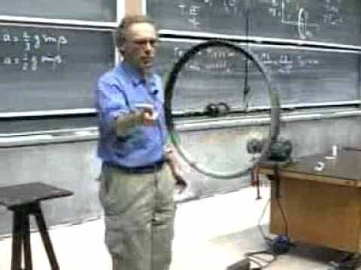
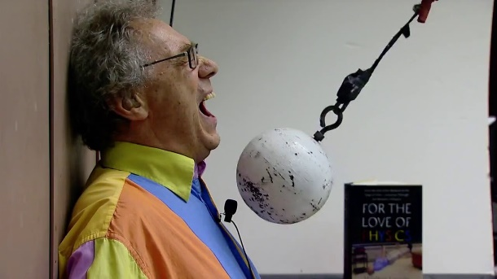
Projects that are currently in the market: 02
Use of physical samples of cubes, spheres and other such shapes while teaching, to help students visualize the structure in a 3D space.
But it is inconvenient for the teacher to carry the specimens around. And It could sometimes be dangerous.

Slide 8
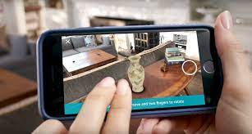
Projects that are currently in the market: 03
The increase of native mobile applications and native desktop Applications has been increased.
They either require hardware components or special software to be installed and are not sharable

Slide 9
Augmented Entities in Real World for E-learning
Proposed Design:
Make Image Models
Upload GLTF models into web app
CMAERA FEED
WEBXR
API
AR ENGINE

Slide 10
Augmented Entities in Real World for E-learning
Description:
We are building a system for students that can help teachers to better explain concepts and use modern Augmented reality technology and create GLTF models using #D modeling software like Blender.
GLTF stands for Graphics Language Transmission Format which is portable and creatable and can hold 3D model data in a very efficient way.
We are using WEBXR API where XR stands for Extended reality which include AR and VR for the web

Slide 11
Augmented Entities in Real World for E-learning
Expected Deliverables:
A fully fledged Augmented reality based web Application which is capable of rendering 3D models in any device that has a camera and a web browser.

Slide 12
Augmented Entities in Real World for E-learning
References:
[1] S. Patil, C. Prabhu, O. Neogi, A. R. Joshi and N. Katre, "E-learning system using Augmented Reality," 2016 International Conference on Computing Communication Control and automation (ICCUBEA), 2016, pp. 1-5, doi: 10.1109/ICCUBEA.2016.7860038.
[2]R. Aggarwal and A. Singhal, "Augmented Reality and its effect on our life," 2019 9th International Conference on Cloud Computing, Data Science & Engineering (Confluence), 2019, pp. 510-515, doi: 10.1109/CONFLUENCE.2019.8776989.
[3] F. Liarokapis, P. Petridis, P. F. Lister, and M. White,
“Multimedia Augmented Reality Interface for E-Learning (MARIE),”World Transactions on Engineering and Technology Education. Brighton, England, vol. 1, no. 2, pp. 173–176, 2002

Slide 13
Hand Gesture Controlled Wheelchair
Any Questions/Discussions ???

Slide 14
Hand Gesture Controlled Wheelchair
Thank You !!!

